Slide 1
Python/GalSim Image Simulator
Progress Report
April 22, 2015
Aaron Bunch
NASA/JPL

Slide 2
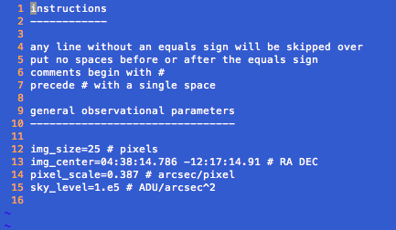
Observational Parameters Text File

Slide 3
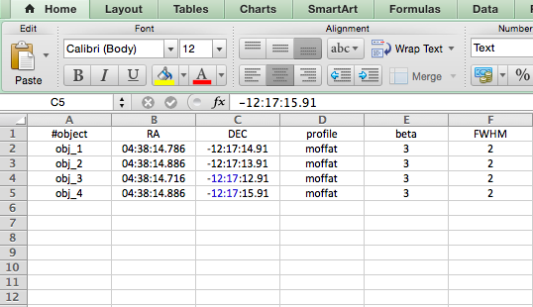
Object Parameters CSV File

Slide 4
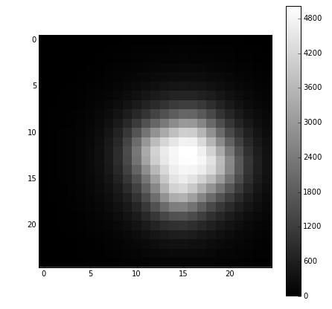
FITS Output

Slide 5
To Do:
Add more object profiles and parameters
De Vaucouleurs profile
Sersic profile
Ellipticity
Rotation
Integrate light curve simulations

